Slide 1
CANADIAN NATIONAL MASTER
CKC SENIOR HUNT TESTS
2018
(Long Version)
Notes:
Sources For Good Information on Judging, Field Work and Setting up Good Tests
(Copy links into your browser)
Retriever Field Trial Judging – A Manual - “The Blue Book” Aimed at field trial judges but carries a large amount of information that would translate well to hunt tests and WC/I/X work
https://www.theretrievernews.com/store/p7/Judge%27s_Manual_%28Digital_eBook_Edition%29.html
Retrievers ONLINE - Dennis Voigt has published many outstanding articles on judging in his Retrievers ONLINE magazine and currently appear on his blog.
http://www.retrieversonline.com/
Retriever Field Trial Judging Fundamental and Checklist
http://cdn.agilitycms.com/retrievers-online/AMJ_2012_Judging%20Checklist-hi%20res.pdf
Retriever News
https://www.theretrievernews.com/
CKC Rules and Regulations
https://www.ckc.ca/en/Files/Forms/Shows-Trials/Event-Rules-Regulations/Hunt-Test-Rules-and-Regulations-for-Retrievers-Bar
It is easy to set up tests that eliminate dogs - all dogs can be tricked – but that is not the role of a judge. Judges should be on the dog’s side when judging – not to give it an easy pass – but to bring out the best that dog has to offer on that day.

Slide 2
Table of Contents
TOPIC | SLIDE
Purpose of CKC Hunt Tests | 3
Key Hunt Test Definitions | 4 - 6
Senior Test Requirements | 7
Senior Test Design Considerations | 8 - 11
Evaluating the Senior Dog General Talking to the Dog Recasting the Dog Handling on Marks Steadiness Interference Switching Lining the Dog Upland Hard Mouth Sample Senior Score Sheets | 12 - 28
CKC Hunt Test Performance Standards and Fault Classification | 29 - 43
Serious Handler Faults | 44 - 45
Gun Safety | 46 - 47

Slide 3
Purpose of Hunt Tests
The purpose of the hunt test for Retrievers, Barbet, Irish Water Spaniels and Standard Poodles is to test the merits of, and evaluate the abilities of these dogs in the field in order to determine their suitability and ability as hunting companions
Hunt tests should, therefore, simulate as nearly as possible the conditions met in a true hunting situation
- Section 13.1.1 of CKC Rules and Regulations
The purpose of the Senior Hunt Test is (also) to encourage owners to train in advanced work
- Section 11.2.1 (b) of CKC Rules and Regulations

Slide 4
Key Hunt Test Definitions
Break
Dog leaves to retrieve without release by handler and is not brought under control
Controlled Break
Dog leaves to retrieve without release by handler but is quickly brought under control verbally or by whistle and returns
In Master, a controlled break calls for a “0” score except in the Upland series where it is considered a minor fault when the dog is brought under immediate control
Creeping
Leaving the handler on a tentative yet excited basis, short of leaving completely
General unsteadiness
Can be a safety issue
Notes:
Break
A break occurs when a dog makes a movement which, in the opinion of the judges, indicates a deliberate intent to retrieve without having been ordered to do so, and cannot be brought under control by the handler
Controlled break
Controlled break is when a dog leaves before being sent but is quickly brought under control by verbal command or whistle and returns to the handler
Discussion should take place at this time on controlled breaks. Controlled break can also occur when the dog stops on its own without handler communicating verbally. If the dog is watching the marks, leaves the handler’s side stops a few feet or more without handler saying sit of whistling, this is a controlled break. Controlled breaks are only while marks are going down or in Master on the sit to flush.
Creeping
Creeping is considered as leaving the handler on a tentative yet excited basis, short of leaving completely to retrieve the bird, or waiting to be sent to retrieve. General unsteadiness short of breaking:
Creeping can be a safety issue in a real hunting situation.
As a guide in their instructions to participants, judges may wish to use a hypothetical creep line of “no creeping beyond the end of the gun barrel”.

Slide 5
Key Hunt Test Definitions Cont’d
Pop
A pop, or popping, is voluntary stopping (without command) and looking back to the handler for direction after having been sent
Diversion Bird
A bird that is thrown and acts to divert the dog from their task at hand as it occurs
Occurs while the dog is actively working in the field as opposed to being at the line
Poison Bird
A poison bird is a mark, seen from the line, that is left in the field while the dog picks up a blind
If the judge chooses to have the poison bird picked up after delivery of the blind, it will be judged as a mark
Notes:
Popping
Popping is characterized as a voluntary stopping (without command) and looking back to the handler for direction.
Discussion could take place at this point with regards to whether a pop also constitutes a dog running/moving forward but glances back.

Slide 6
Key Hunt Test Definitions Cont’d
Recast
Distance for an allowable recast should be agreed upon by judges but is usually limited to 15 feet or 4.5 meters
Usually attributed to a dog’s confusion as to whether it was sent
It is not considered a recast when a dog goes to the area of the fall, fails to find the bird and returns (or is recalled)
This must be evaluated as a lack of perseverance
Refusal
Refusal is a disregard of a command
Failure to stop and look at the handler when signalled or failure to continue in new direction for a considerable distance both constitute a refusal
Not coming when called is as bad as not going when sent
Notes:
Recast
Distance should be agreed upon by judges but is usually limited to 15 feet or 4.5 meters……
Discussion could take place with regards to some of the grey areas around recasts and no-gos. Did the dog hear the handler? How should the dog be evaluated?
Refusal
Refusal is disregard of a command. Failure to stop and look to the handler when signalled, failure to continue in that new direction for a “considerable” distance constitutes refusal. Not coming when called is as bad as not going when sent.
Discussion could take place at this point with regards to what is considered as a “considerable” distance – 3 feet, 5 feet, 10 feet?

Slide 7
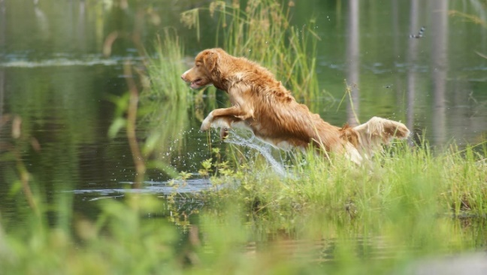
Senior Test Requirements
A minimum of 5 hunting situations shall be tested as follows:
One land blind
One water blind
One set of double land marks
One set of double water marks
An Upland hunting test
Each of these hunting situations can be considered a “series”
Notes:
The blinds may be run as a double blind, one placed on land and one placed on water.
In the Upland potion of the test, the dog may be urged to hunt or handled to maintain his range and position. The bird(s) must be placed in cover within the test area. When located, the birds must be retrieved by the dog to the handler. Dead birds shall be used.
- 9.2.1(e)

Slide 8
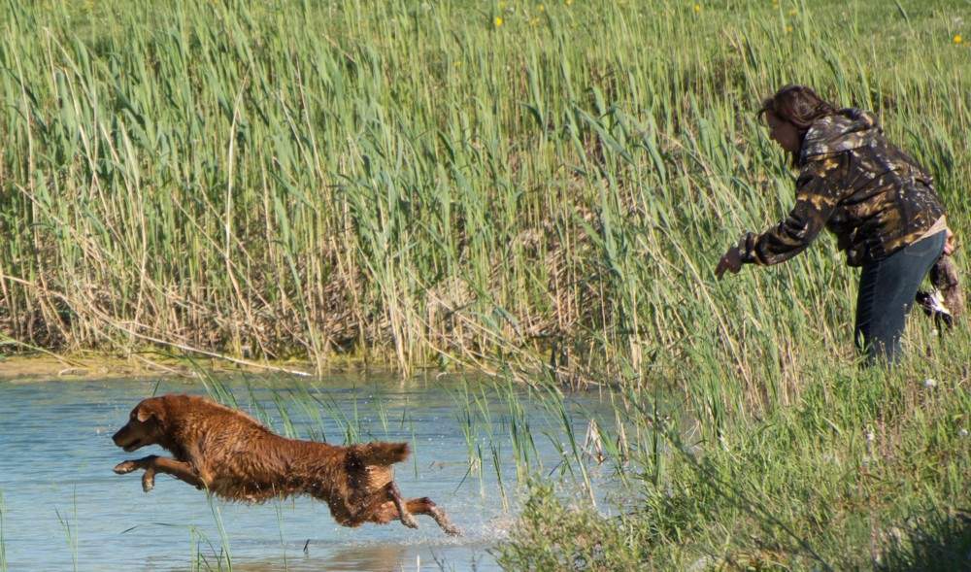
Senior Test Design Considerations
No marked retrieve shall normally exceed 73.1m (80 yards) and no mark should be thrown inside of 20 yards from the line
There shall NOT be any walk-up test in Senior
Each dog must honour a working dog at least once
On the honour, the honour dog must be placed so that it is unlikely the working dog will cross in front of it
Diversion shot(s) shall be used, but diversion birds shall NOT be used
Notes:
Discussion can take place on what diversion shots/birds are and why they are part of the tests. Also, why diversion shots can be used at Senior but not diversion birds.
Diversions
A diversion bird is thrown while the dog is out actively working in the field, not on the line. It diverts the dog from their task at hand as the task occurs.
A poison bird is a mark as it is marked from the line. The term poison bird is used to describe the concept of leaving the mark in the field while picking up a blind.

Slide 9
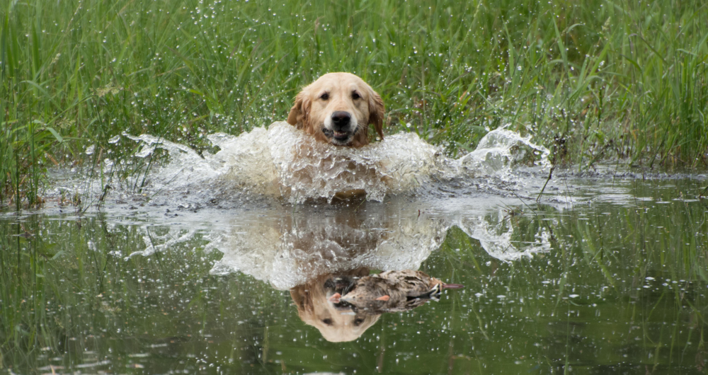
Senior Test Design Considerations: Cont’d
As in Junior and Master, situations must simulate natural and realistic hunting situations
Test situations should make use of natural hazards, hunting equipment and obstacles encountered in hunting as much as is practicable
Visible gun stations should be kept to a minimum
Judges shall require the handler to shoulder or carry an empty shotgun or replica on at least TWO occasions
Safe gun handling is to be observed

Slide 10
Senior Test Design Considerations: Cont’d
Blinds
May be run as a double blind: one on land and one on water
Should be no longer than 73.1m (80 yards) and be as open as possible
Should be run on grounds separate from marks
If not possible to use separate grounds for the blinds, judges MUST ensure previous marks do not influence or interfere with the blind
No blind is to be run between the marks
If the same piece of land or water is used for both blinds and marks, blinds MUST be run first
On water, shoreline blinds, heavy cover and re-entries are to be avoided
The line for the blind should be as close to the water as possible to avoid cheaty entries

Slide 11
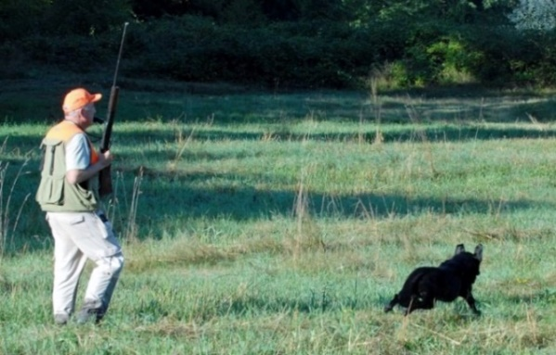
Senior Test Design Considerations: Cont’d
Upland
Dead birds shall be used
The dog shall be required to locate birds as in typical upland hunting
Both dog and handler should maintain gun range
One to three birds must be placed in cover within the test area
Notes:
Discuss the positioning of blinds versus marks at a Senior test.

Slide 12
Evaluating the Senior Dog: General
A retriever’s prime purpose is to get bird to hand as quickly as possible in a pleasing and obedient manner using both natural and trained abilities
Judges must numerically evaluate, each out of 10, the following defined set of abilities against a standard as described in the CKC Rules and Regulations
Marking
Style
Perseverance
Training
These abilities will be NOT be graded in relation to the performance of the other dogs
Scores must be shown to handlers upon request
Notes:
These abilities (Marking, Style, Perseverance, trainability) will NOT be defined in relation to the performance of the other dogs but instead against the standard as set out in the CKC hunt test rules and regulations.
Judges should compare their scores early in the test and throughout the test to see if they are relatively consistent in their numbers.

Slide 13
Evaluating the Senior Dog: General
Trainability, as evidenced in steadiness, control, response and delivery, must be assessed to a greater degree than in Junior
To qualify, an average score of 7 for the whole test (all series) must be achieved and must NOT include a score below 5 in any one ability (Marking, Style, Perseverance, Training)
When a dog is graded “0” by two judges on the same ability, it shall not be called back
A zero score is different from a non-score
A “0” indicates that the dog had an opportunity to exhibit an ability but failed to do so
A “non-score” indicates that an opportunity for the dog to exhibit an ability did not present itself
The ability to mark is of primary importance
Birds located by the dog must be retrieved to hand
Notes:
To qualify, an average of 7 for the whole test must be achieved and must not include an average score below 5 in any one ability. Example: A score of 9 in some categories could fail to qualify if average score in one category is below 5.
Possible Scoring Methods:
Determine whether dog should qualify in that ability category, which might mean an ability score of 5. Knowing the dog must have an overall average of 7, the judge considers whether other abilities deserve a 7 or higher. With a five or less (but not with a zero by both judges), the dog would have to score higher in that ability and other abilities to acquire the 7 overall average.
A judge might want to compare the scores to grades received in school. For example, a 5, 6 or 7 might be comparable to a passing grade of C, an 8 would be a B, etc.
Another method could begin with a perfect score of 10 and progress downward.
Judges should take time to review and check their scores with each other before their scores become final.

Slide 14
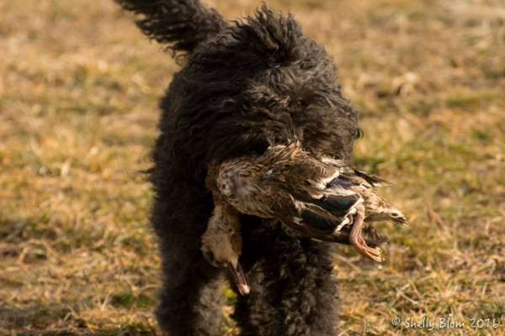
Evaluating the Senior Dog: General Cont’d
It is sufficient cause to grade a dog “0” in marking or perseverance (unless judge feels valid mitigating circumstances exist) if a dog, having been sent to retrieve a mark,
Returns to its handler before finding a bird, with or without having been called in, except when dog is confused as to whether it was really ordered to retrieve;
Stops its hunt; or
Fails to pick the bird up after finding it

Slide 15
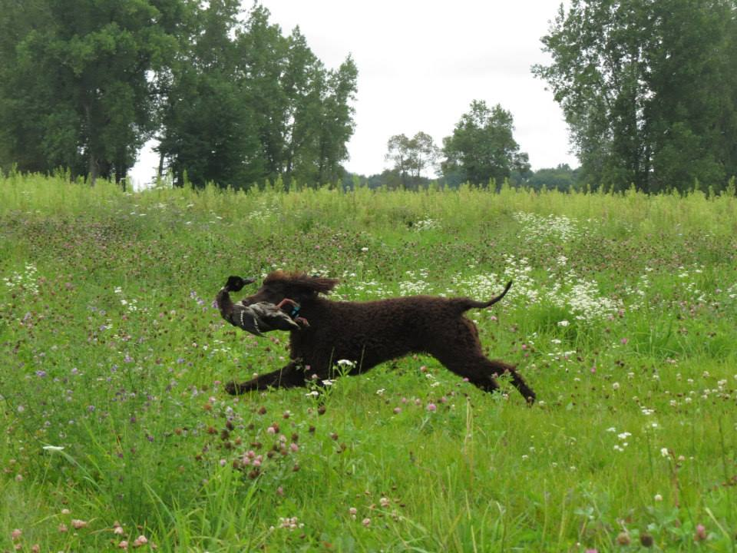
Evaluating the Senior Dog: General Cont’d
Any of the Serious Dog Faults described in section 16.3.1 of the CKC Rules and Regulations can be cause to award a dog “0” in the relevant scoring category
Repeated incidences of moderate and/or minor dog faults in sections 16.4 and 16.5 can also accumulate to be more serious in nature to the point of being non-qualifying
See section on Performance Standards and Fault Classification in this presentation for detail
Notes:
“In marking situations, a handler may give the dog a line in the direction of the fall, provided that such lining is accomplished briskly and precisely. Conspicuously intensive lining suggests a weak marking ability and the dog must be graded low in marking. The handler shall NOT line a dog in the direction of any fall or gun station until all the falls are down.”
- Section 12.6 pg. 46

Slide 16
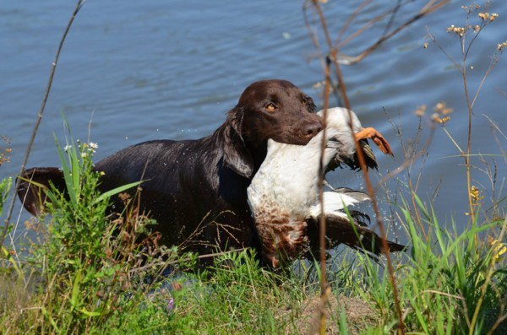
Evaluating the Senior Dog: Talking to the Dog
In Senior, it is desirable that the handlers of both working and honouring dogs remain silent from the time the first shot is fired until the dog is released by the judge
However, the handler may very quietly give an occasional command without incurring a penalty
Talking to the dog in Senior is considered a minor fault

Slide 17
Evaluating the Senior Dog: Recasting the Dog
A Senior dog may be sent to retrieve more than once, but judges must consider this when evaluating marking and perseverance and normally calls for lower grades in these areas
A recast occurs when a dog makes a start toward a marked fall, but stops within a short distance of the line (approx. 5 yards or 4.5 meters) and returns or is recalled to the handler after which the dog is sent to retrieve again
This is often the result of the dog’s confusion as to whether it was sent to retrieve the first time
It is NOT considered a recast when the dog goes to the area of the fall, fails to find the bird or blinks a bird it has found, and returns or is recalled to the handler
This must be regarded as a lack of perseverance and can merit grading the dog “0” in marking or perseverance unless the judges perceive valid mitigating circumstances
Notes:
Discussion should take place at this point by asking the question, “How do you distinguish between a refusal and confusion?”
Factors to consider are:
Did the dog hear the command?
Was the command too loud so as to startle the dog?
Could the conditions that the dog is expected to enter be considered to test their perseverance such as cold or murky water (possibly leading to a refusal)
Discussion and explanation around the statement as quoted below could take place. What if a judge assigns “0” in BOTH marking AND perseverance under these circumstances?
“This must be regarded as a lack of perseverance and can merit grading the dog “0” in marking or perseverance unless the judges perceive valid mitigating circumstances”
- Marking OR perseverance.

Slide 18
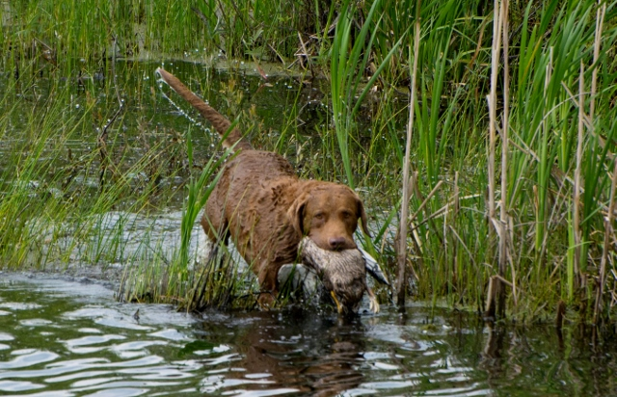
Evaluating the Senior Dog: Handling on Marks
Perseverance should be encouraged on marked retrieves, however, dogs may be handled on marks
Excessive handling requires a lower score in perseverance
A dog which proceeds to the area of the fall and finds the bird on its own should be scored appreciably higher than a dog that must be handled to a bird

Slide 19
Evaluating the Senior Dog: Steadiness
The Senior dog is to work off leash from the time it leaves the holding blind until it is behind the judges at the completion of the series
Handlers must not pull out leashes or other training devices until behind the judges
Dogs should be steady on the line for marks and for the honour
The handler may not hold or touch a dog to keep it steady; this is a serious handler fault which can merit elimination
A controlled break is allowed in Senior; it is considered a moderate fault
Creeping is categorized as a minor dog fault
Notes:
Discussion should take place at this point by asking the question, “How do you distinguish between a refusal and confusion?”
Factors to consider are:
Did the dog hear the command?
Was the command too loud so as to startle the dog?
Could the conditions that the dog is expected to enter be considered to test their perseverance such as cold or murky water (possibly leading to refusal)

Slide 20
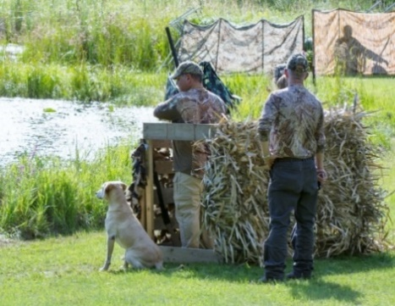
Evaluating the Senior Dog: Steadiness Cont’d
Greater leeway on steadiness is to be granted to the Senior dog in its trainability score than a Master dog
Conversely, a controlled break or creeping should result in a relatively lower score in trainability than it would in a Junior test
A controlled break on the honour must not interfere with the working dog

Slide 21
Evaluating the Senior Dog: Interference
In the case of another dog breaking for the same fall as the working dog and interfering with the working dog that in any way causes a faulty performance, the working dog should be considered as not having been tested and given another opportunity to be evaluated
If the handler of an honouring dog makes a noise or command which might interfere with the working dog, the judges have the discretion to remove the offending team from the test

Slide 22
Evaluating the Senior Dog: Switching
A dog is considered to have switched if it:
Goes to the area of a fall, hunts, fails to find the bird and then leaves the area to hunt for another fall; or
Drops a bird it is retrieving and goes for another bird
Unless the judges agree that valid mitigating circumstances exist, a dog that switches shall be scored “0” in perseverance and eliminated
It should NOT be considered a switch, and therefore lack of perseverance, if the dog:
Finds another bird on the way to one fall and retrieves it first, or
Changes direction on the way out to one fall, does not establish a hunt and retrieves another bird

Slide 23
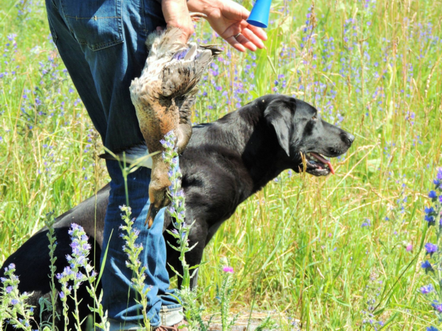
Evaluating the Senior Dog: Lining the Dog
In marking situations, the handler should not line a dog with his or her hand in the direction of any fall or gun station until all falls are down
A handler may give the dog a line in the direction of the fall, provided that such lining is accomplished briskly and precisely
Conspicuously intensive lining with the hand suggests a weak marking ability and the dog must be graded low in marking
Notes:
“In marking situations, a handler may give the dog a line in the direction of the fall, provided that such lining is accomplished briskly and precisely. Conspicuously intensive lining suggests a weak marking ability and the dog must be graded low in marking. The handler shall NOT line a dog in the direction of any fall or gun station until all the falls are down.”
- Section 12.6 pg. 46

Slide 24
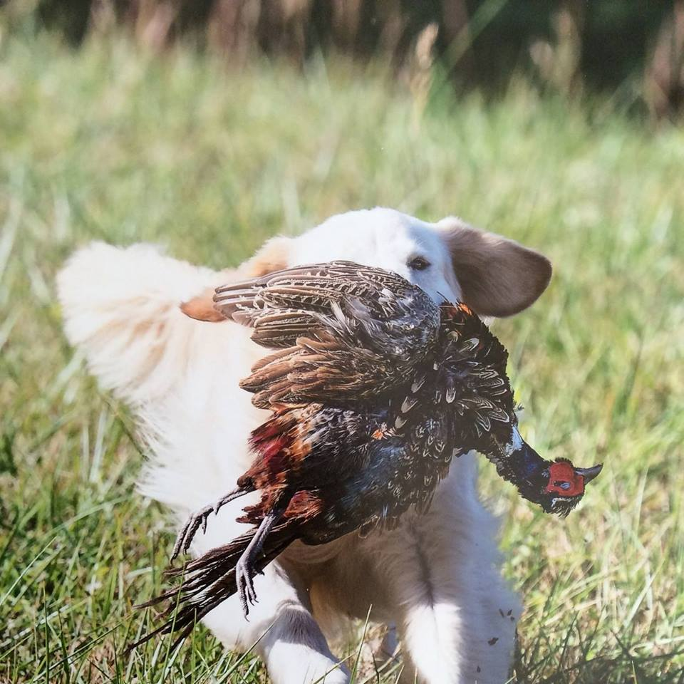
Evaluating the Senior Dog: Upland
The dog shall be required to locate birds as in typical upland hunting and within gun range of the handler
The dog may be urged to hunt or be handled to maintain his range and position
When located, the birds must be retrieved by the dog to hand

Slide 25
Evaluating the Senior Dog: Hard Mouth
Hard mouth is one of the most undesirable traits in a retriever
A dog can carry the stigma for life and therefore hard mouth requires incontrovertible proof
Torn skin or flesh alone is not usually sufficient evidence for proof as it may be caused in a variety of ways, such as by sharp sticks or stones, etc. in the cover as well as by the dog’s fast, positive pick-up
Crushed bone structure can usually be accepted as trustworthy and sufficient evidence of hard mouth

Slide 26
Evaluating the Senior Dog: Hard Mouth Cont’d
Other undesirable traits are frequently confused with hard mouth such as freezing with bird in mouth
A hard mouthed dog may still have a gentle delivery and a reluctant or sticky delivery does NOT imply hard mouth
Rolling or mouthing the bird during a retrieve may be erroneously associated with hard mouth as well even when the bird is not damaged
Such mouthing may not necessarily call for a lowering of a trainability score
The judge should remember a dog either does or does not have a hard mouth, and if it does, cannot receive a qualifying score

Slide 27
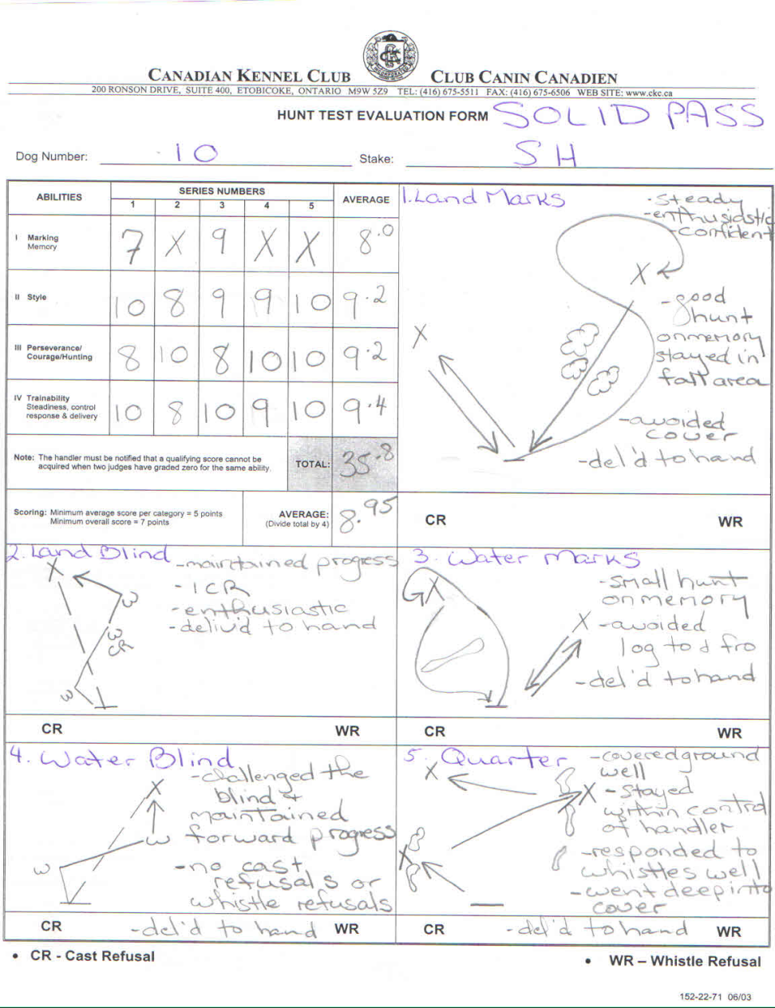
Evaluating the Senior Dog: Sample Score Sheet
Notes:
Senior Test usually consists of the following: One land blind, One water blind, One set of double land marks, One set of double water marks, an Upland hunting test in which the dog shall locate birds as in a typical upland hunting situation, maintaining gun range with the handler
To qualify, an average score of 7 for the whole test (all series) must be achieved and must NOT include an average score below 5 in any one ability (Marking, Style, Perseverance, Trainability)
Possible Scoring Methods:
Determine whether dog should qualify in that ability category, which might mean an ability score of 5. Knowing the dog must have an overall average of 7, the judge considers whether other abilities deserve a 7 or higher. With a five or less (but not with a zero by both judges), the dog would have to score higher in that ability and other abilities to acquire the 7 overall average.
A judge might want to compare the scores to grades received in school. For example, a 5, 6 or 7 might be comparable to a passing grade of C, an 8 would be a B, etc.
Another method could begin with a perfect score of 10 and progress downward.
Judges should take time to review and check their scores with each other before their scores become final.
The score sheet sample above represents a SOLID PASS.

Slide 28
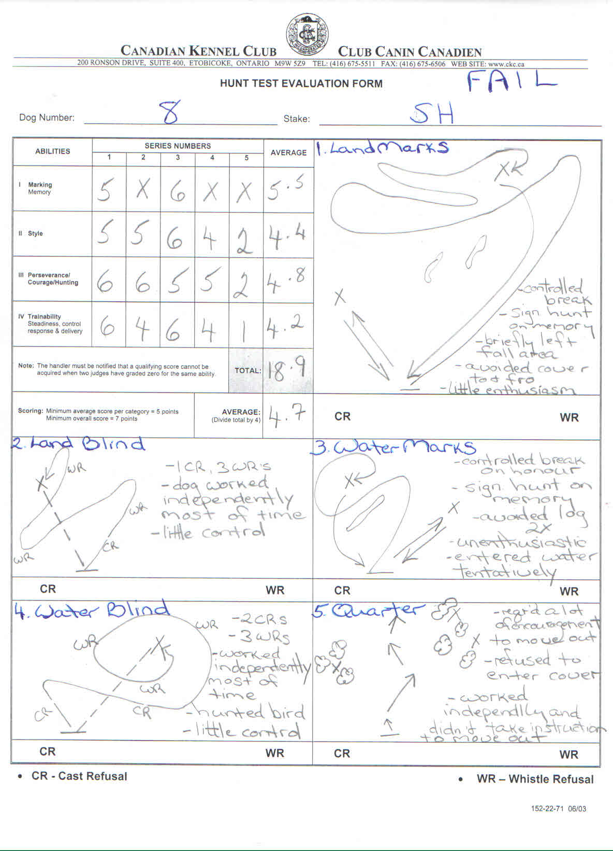
Evaluating the Senior Dog: Sample Score Sheet
Notes:
Senior Test usually consists of the following: One land blind, One water blind, One set of double land marks, One set of double water marks, an Upland hunting test in which the dog shall locate birds as in a typical upland hunting situation, maintaining gun range with the handler
To qualify, an average score of 7 for the whole test (all series) must be achieved and must NOT include an average score below 5 in any one ability (Marking, Style, Perseverance, Trainability)
Possible Scoring Methods:
Determine whether dog should qualify in that ability category, which might mean an ability score of 5. Knowing the dog must have an overall average of 7, the judge considers whether other abilities deserve a 7 or higher. With a five or less (but not with a zero by both judges), the dog would have to score higher in that ability and other abilities to acquire the 7 overall average.
A judge might want to compare the scores to grades received in school. For example, a 5, 6 or 7 might be comparable to a passing grade of C, an 8 would be a B, etc.
Another method could begin with a perfect score of 10 and progress downward.
Judges should take time to review and check their scores with each other before their scores become final.
The score sheet sample above represents a SOLID PASS.

Slide 29
CKC Performance Standards and Fault Classification
In the Canadian Kennel Club rule book:
Performance Standards provide a model for exemplary performance and,
Faults Classification provide an aid to assessing how a performance deviates from the ideal until the point of being unacceptable
Note that, in order to facilitate discussion on judging, both the Performance Standards and Faults Classification apply to all 3 test levels and should be judged accordingly except where a specific test level is referred to

Slide 30
Performance Standards: Marking
A good to excellent marking performance may be defined when the dog:
Gives indications of having marked the fall and proceeds to the general area of the fall
Indicates a clear line to the fall and recognition of the depth of the fall
Proceeds directly to the area of the fall and puts on a focused hunt for the bird with little straying from the area of the fall
Quickly and systematically locates the bird
A dog that misses the fall on the first cast but recognizes the depth of the area of the fall, stays in it, then quickly and systematically hunts it out has done a creditable job of marking
Notes:
It can be useful to define the area of the fall to the handlers in advance; especially at the Junior and Senior levels. Since the judges should have agreed upon this already, it could be shared with the handlers.
Ability to mark does not necessarily imply pin-pointing the fall, but a dog should proceed directly to the area of the fall and establish a hunt. A dog that misses the fall on the first cast but recognizes the depth of the area of the fall, stays in it, then quickly and systematically hunts it out has done both a creditable and an intelligent job of marking. - 15.1.2
Marking or memory of falls is of paramount importance. However, this does not imply that dogs which excel in marking shall not be scored lower, even to the extent of not receiving a qualifying score, for deficiencies in, or a lack of the other required abilities.
In determining the arbitrary boundaries of the area of the fall, due consideration should be given to many factors:
Type, height and uniformity of cover
Light conditions
Wind direction and intensity
Length of the various fails
Location of fall (beyond a hedge, across a road, etc.)
Single, multiple or 2nd or 3rd bird
Discussion could take place at this point with regards to possible additional factors.

Slide 31
Performance Standards: Marking Cont’d
Determining the arbitrary boundaries of the area of the fall should consider cover, terrain, light, wind, distance and location of fall etc.
What are other factors that should be considered?
It can be useful to define the are of the fall to the handlers in advance; especially at the Junior and Senior levels
It is important to understand that when a dog disturbs cover unnecessarily, is clearly out of the area of the fall and has not been handled, it should be scored lower on marking than if it was handled quickly and obediently to the bird (as per section 15.1.7. of the CKC rule book)
Notes:
Evaluations should take into consideration the distance which a dog wanders out of the area of the fall, the frequency of such wandering, the number of birds mismarked and the amount of cover disturbed in these wanderings.

Slide 32
Classification of Faults: Marking
Serious:
In Junior, handling on more than one mark
Multiple birds mismarked
Failure to find a bird which should have been found
Moderate
Failure to proceed directly to the area of the fall and initiate a hunt, disturbing cover clearly out of the area of the fall
In Master, failure to go directly to the area of the fall and set up a hunt, requiring the dog to be handled
Conspicuously intensive lining after the falls are down suggests weak marking
Minor
In Junior, single recast
Handling “on” a mark as opposed to “to” a mark
Notes:
Under minor faults, handling “on” a mark has quotes around it to distinguish between handling “on” vs handling “to” a mark.
The distinction between “on” and “to” is based on proximity.
A classic example of handling “on” a mark is when a dog takes a good line and ends up passing the bird a couple of feet on the upwind side. In this case, if the handler quickly whistles and handles “on” to the bird, this would be a minor fault. The hunt test rules say that a quick handle is better than a long hunt. When a dog puts on a big hunt and is not close to the bird and needs to be handled a longer distance, this handling “to” the mark. Often judges are heard to say that two handles of this kind will result in a fail, so these handles should be seen as moderate faults.
“In marking situations, a handler may give the dog a line in the direction of the fall, provided that such lining is accomplished briskly and precisely. Conspicuously intensive lining suggests a weak marking ability and the dog must be graded low in marking. The handler shall NOT line a dog in the direction of any fall or gun station until all the falls are down.”
- Section 12.6 pg. 46

Slide 33
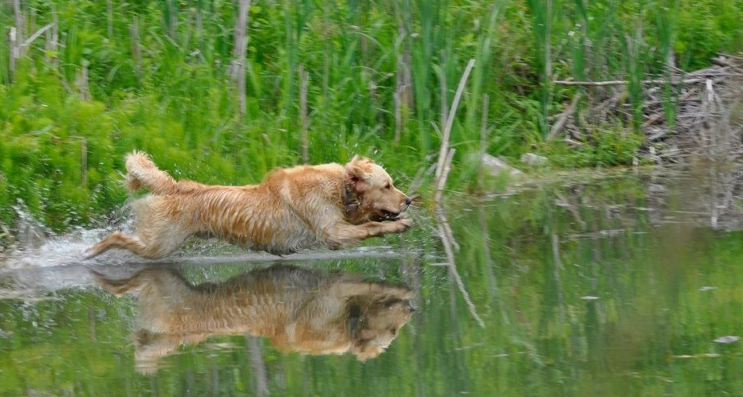
Performance Standards: Style
Good to excellent style may be defined when the dog shows:
An alert and obedient attitude
Determined departure on land and into water
An aggressive search for the fall, a prompt pick-up, and
A reasonably fast return
Absence of these style components should be reflected in a dog’s score, even to the point of scoring a dog “0” on style
Notes:
Discussion could take place at this point on additional elements of style such as body language – ear and tail position.
How does speed factor into style? For example if the dog is older or dysplastic?

Slide 34
Classification of Faults: Style
Serious:
In Master Upland test, excessive handling to maintain range and position
Moderate:
Hunting in a slow, lackadaisical, disinterested manner
Lack of alert, obedient attitude, lack of determined departure on land or on water, lack of aggressive search for the fall, lack of prompt pick up and return
Minor
Lack of attention
Slow pick-up of a dead bird (except when fluttering or badly shot up
Dropping bird or handling bird in a sloppy manner

Slide 35
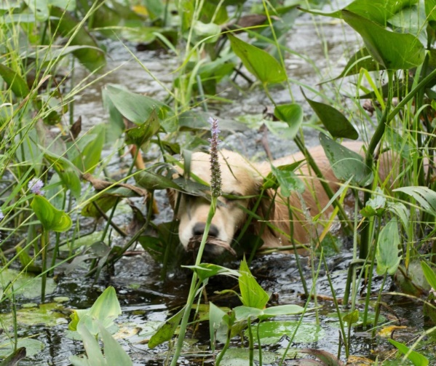
Performance Standards: Perseverance
Perseverance and courage in hunting is shown by a dog’s determination to stick at it and complete the task at hand (i.e. systematically, aggressively, and without faltering) to search for and find the bird he is to retrieve
Willingness to face, without hesitation and repeatedly, rough cover, cold or rough water, ice, mud or other similar conditions which make the going tough

Slide 36
Classification of Faults: Perseverance
Serious
Failure to enter uncomfortable circumstances (e.g. rough cover, water, ice, mud) after having been ordered to do so several times
Switching birds - Establishing a hunt in one area of the fall, then giving up and establishing a hunt in another area of the fall; or drops a bird retrieved and goes for another
On a mark, returning without the bird, except in a recast situation
Stops its hunt
“Blinks” a bird – fails to pick the bird up and leaves it after making the find
Notes:
Failure to enter potentially uncomfortable circumstances – Section 12.13 – In Senior and Master failure to enter either rough cover, water, ice, mud, or any other situation involving unpleasant or difficult going for the dog, after having been told to do so several times, is sufficient cause to grade the dog “0” in perseverance.
Section 9.3.4:
“Dogs that switch shall be scored “0” in perseverance and cannot receive a qualifying score.”
Discussion should take place on the influence of tightness of marks on switching (first bird picked up, dog sent to second area of fall, can’t find it, goes back to first mark. Is this a switch if marks are tight? This should be discussed by judges before evaluations begin.
“Blinking” a bird is a failure to pick up a bird leaving it after making the find. Judges should confer when there is a question of a dog blinking a bird.

Slide 37
Classification of Faults: Perseverance Cont’d
Moderate:
Reluctance to enter uncomfortable circumstances (e.g. rough cover, water, ice, mud) or other situations involving unpleasant going for the dog
Popping on a marked retrieve –stopping and looking back to handler for directions on a mark
Minor:
Popping, stopping and looking back for directions on a blind retrieve where there are no extenuating circumstances
In Junior, a single recast
Notes:
Discussion could take place on what could be defined as “extenuating circumstances” against Minor Faults on a pop.

Slide 38
Performance Standards: Trainability
Trainability consists of those abilities that the dog acquires through training
Steadiness: Lack of movement on the line
Control: Closely aligned to the dog’s response to direction and includes obedience and line manners
Response: Important in handling tests and in situations where a dog must be brought back to the area of the fall when it has mismarked
Delivery: Bird must be delivered to the handler directly upon return from the retrieve and given up willingly
Notes:
Trainability
Trainability score will vary with both the nature of the test being scored and the extent to which a dog might be unresponsive. Before scoring a dog lower on trainability for its failure to stop promptly at a whistle, judges should determine whether the wind, cover or the distance seriously interfered with the dog’s ability to hear its handler. In general, the response displayed should be considered in its entirety; an occasional failure to take and hold a direction may affect a trainability score only slightly, if offset by several other very good responses.
To the extent that a dog might not receive a qualifying score, a trainability score must reflect repeated and willful disobedience of the handler’s orders. In addition, but to a lesser extent, a trainability score must show that, after taking the proper direction, the dog did not continue on it as far as the hander desired. Stopping voluntarily to look back for direction, in an isolated instance, may warrant a moderate or slight lowering of a trainability score, but frequent stopping can result in a zero (0) score.

Slide 39
Classification of Faults: Trainability - Steadiness
Serious:
In Master, a break or controlled break by the working or honouring dog results in mandatory elimination, except in the Upland test where a controlled break is allowed on the flush
Moderate:
In Senior, a controlled break, after which the dog is brought under control and providing it does not interfere with the working dog
Extreme or persistent creeping or serious lack of steadiness and general poor line manners
In Master, talking to the working or honouring dog
Notes:
Steadiness
In a Master hunt test the handlers of the working and honouring dogs should remain silent from the time the first shot is fired until the dog is released by the judge.
However, the handler may very quietly give an occasional command to facilitate a difficult-to-see mark without incurring a penalty.
Any speaking to the dog once the first shot is fired detracts from a perfect performance and must be reflected in the trainability score.
Repeatedly speaking to the dog within one series or during more than one series indicates either an undesirable lack of steadiness or a lack of marking ability and must be scored “0”.
A handler may speak quietly to his dog to prevent forward motion but repetition of this fault will necessitate a “0” in trainability.
At any time, if the judges deem the handler to be loud or intimidating, the score will be scored “0”.
Section 12.6 (c)
Discussion could take place on what constitutes an allowable “controlled break” on the flush in Master.

Slide 40
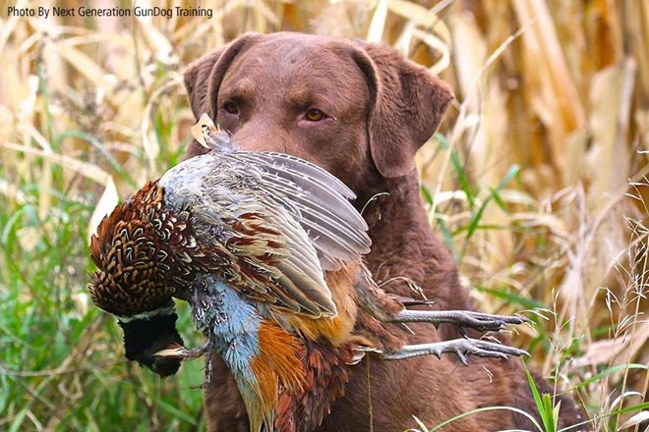
Classification of Faults: Trainability – Steadiness Cont’d
Minor:
Unsteadiness on the line, including creeping
In Junior, controlled break
In Master, controlled break in Upland
In Senior and Master, creeping
In Senior, talking to the working dog or honouring dog
It is desirable that the handler remain silent from the time the first shot is fired until release by the judge

Slide 41
Classification of Faults: Trainability - Control
Serious:
Dog is allowed to hunt extensively after handling on a mark/blind has begun
Dog is out of sight on a blind for an unreasonable time
Loud and prolonged barking or whining
Moderate:
Moderate whining of short duration
Recast
Minor
Slight short whine or one bark on line or on send
In Junior, a single recast
Poor line manners; poor heeling, dropping bird on delivery, jumping after birds, etc.
Notes:
Control
In Senior and Master, includes walking tractably at heel, off lead, assuming and staying I n any designated position on line, as well as remaining quietly on line beside the handler after delivery of the bird.
When called, a dog should return promptly to its handler.
Except for extraordinary circumstances, noisy or frequent restraining of a dog on line by its handler is sufficient cause not to award a qualifying score in Senior and Master.
In less flagrant instances, the trainability score should correspond to the extent that the dog might be deemed to be out of control.

Slide 42
Classification of Faults: Trainability - Response
Serious:
Many refusals unless mitigating circumstances exist
Failure to return when called
Repeatedly popping on a blind
Moderate:
Multiple whistle/cast refusals
Minor:
One whistle/occasional cast refusal unless mitigating circumstances exist
Popping, stopping and looking back for direction on a blind retrieve where there are no extenuating circumstances
Notes:
Response
A dog should respond to direction and continue on until it either makes the find, or until stopped by its handler and given a new direction. Lower scores, even to the extent of grading a dog zero on trainability, based on a lack of response, may be the result of the following:
Not taking the direction originally given by the handler
Not continuing in that direction for a considerable distance
Failure to stop promptly and popping up and looking back for direction
Failure to stop promptly and look to the handler when signalled
Failure to take a new direction when given
Failure to continue in that new direction for a considerable distance
Discuss how judging of Senior and Master should differ in terms of nature and number of cast refusals.
Discuss what additional factors may result in lower scores or “0”.
Discuss what valid mitigating circumstances could exist that result in refusals.
Weather conditions can play a huge part in mitigating circumstances and some land/water that is available could cause issues.
Running through splash water sometimes causes dog to not hear commands/whistles
Discuss what extenuating circumstances could exist if the dog refuses, pops, stops, and looks back for direction on a blind retrieve.

Slide 43
Classification of Faults: Trainability - Delivery
Serious:
Failure to deliver to hand
Freezing – refusal to release a bird for an unreasonable period of time or until compelled to do so
Hard mouth – badly damaging a bird or making it unfit for human consumption which, in the opinion of the judges, was caused solely by the dog without justification
Retrieving a decoy
Minor
Slight freezing – reluctance to give up a bird
Roughness with game
Notes:
Delivery
A dog should not drop the bird before delivering it and should not freeze, or be unwilling to give it up.
A dog should not jump after the bird once the handler has taken it.
A faulty delivery may, depending on the nature of the test, range from a slight lowering of the trainability score for an isolated offense, to the withholding of a qualifying score for a severe freeze or “hard mouth”.

Slide 44
Serious Handler Faults
In Master and Senior, carrying exposed training equipment (example; crop)
Lining a dog in direction of a fall or gun station before falls are down
The handler of an honouring dog makes noise or gives a command loud enough to interfere with the working dog
Unsportsmanlike conduct: Abusing or harassing any person present or kicking, striking or otherwise roughly manhandling a dog
Lack of safe gun handling

Slide 45
Serious Handler Faults Cont’d
Deliberately permitting a dog to see the location of a fall for another dog, or to see the planting or retrieve of a blind
Willfully interfering with another handler or dog
At Master and Senior, exposing leash in front of judges
At Master and Senior, restraining a dog on line
Threatening gestures or intimidation to the dog
Blocking a dog’s view of the bird
Throwing objects to encourage water entry or direct a dog to a fall

Slide 46
Gun Safety
Judges may remove anyone who does not practice gun safety
In accordance with the Canadian Firearms Program, all who handle firearms, including judges, handlers and officials must adhere to the following Vital Four ACTS of firearm safety:
Assume every firearm is loaded
Control the muzzle direction at all times
Trigger finger must be kept off the trigger and out of the trigger guards
See that the firearm is unloaded

Slide 47
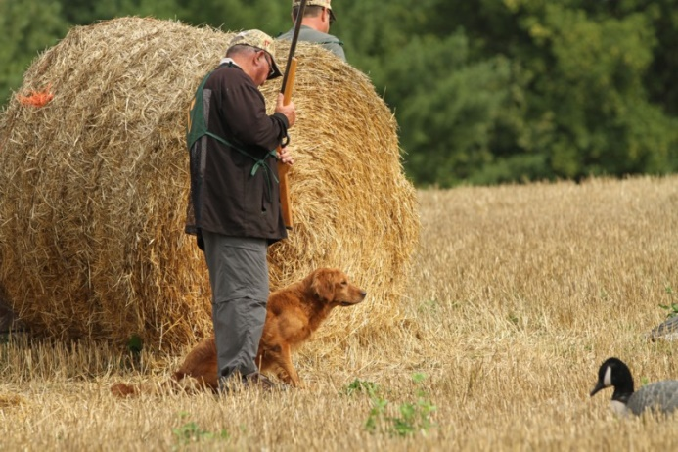
Gun Safety Cont’d
Anyone who handles firearms must also PROVE the firearm safe:
Point the firearm in the safest available direction
Remove all ammunition
Observe the chamber
Verify the feeding path
Examine before each time you pick up a firearm

Slide 48
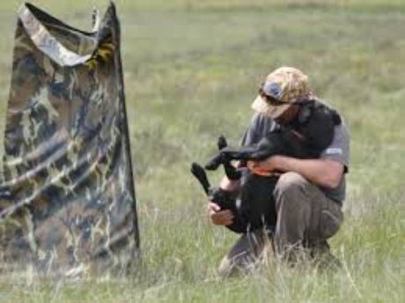
Perhaps Above All
Hunt tests should be an enjoyable sport in which handlers and their dogs get to work as a team and have fun
Thank you!

